Slide 1


3D Face Reconstruction
Presented by: Li-Jung Chen (陳莉蓉)
Phone Number: 0988670963
E-mail: r14922112@ntu.edu.tw
Advisor: Chiou-Shann Fuh (傅楸善)
Digital Camera and Computer Vision Laboratory
Department of Computer Science and Information Engineering
National Taiwan University, Taipei, Taiwan, R.O.C.

Slide 2
Outline
Introduction
Methods
Summary

Slide 3
Introduction
To show the estimated effect of a plastic surgery, we need to do the 3D Face Reconstruction (3D FR) first.

Slide 4
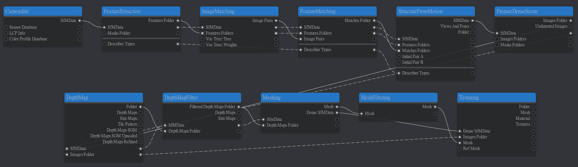
Methods
SfM: Structure from Motion
MVS: Multi-View Stereo
Method 1: traditional SfM + MVS (Meshroom pipeline)
Input images
Output model with texture

Slide 5
Methods
SfM: Structure from Motion
MVS: Multi-View Stereo
EXIF: Exchangeable Image File Format
Method 1: traditional SfM + MVS (Meshroom pipeline)
Camera Init → Feature Extraction → Image Matching → Feature Matching → Structure form Motion
→ Prepare Dense Scene → Depth Map → Depth Map Filter → Meshing → Mesh Filtering → Texturing
Loads images and parses EXIF data (e.g., focal length, sensor size) to estimate initial camera intrinsics.
Notes:
首先是 CameraInit。這一步軟體會讀取所有照片的 EXIF 資訊，像是焦距和感光元件大小，來初始化相機的內部參數，為後面的計算打底。

Slide 6
Methods
SfM: Structure from Motion
MVS: Multi-View Stereo
SIFT: Scale-Invariant Feature Transform
Method 1: traditional SfM + MVS (Meshroom pipeline)
Camera Init → Feature Extraction → Image Matching → Feature Matching → Structure form Motion
→ Prepare Dense Scene → Depth Map → Depth Map Filter → Meshing → Mesh Filtering → Texturing
Detects unique visual descriptors (e.g., SIFT) on every image invariant to scale and rotation.
Notes:
接著是 FeatureExtraction。電腦會去分析每一張照片，找出畫面中獨特的『特徵點』，比如物體的邊緣或角落，確保就算照片旋轉或縮放，電腦也能認得出來

Slide 7
Methods
SfM: Structure from Motion
MVS: Multi-View Stereo
Method 1: traditional SfM + MVS (Meshroom pipeline)
Camera Init → Feature Extraction → Image Matching → Feature Matching → Structure form Motion
→ Prepare Dense Scene → Depth Map → Depth Map Filter → Meshing → Mesh Filtering → Texturing
Uses a vocabulary tree to efficiently identify image pairs with visual overlap, optimizing processing time.
Notes:
再來是 ImageMatching。為了節省時間，我們不需要把每張照片都跟其他所有照片比對，而是利用詞彙樹快速篩選出『哪些照片拍到了同一個區域』，建立初步的配對關係。

Slide 8
Methods
SfM: Structure from Motion
MVS: Multi-View Stereo
Method 1: traditional SfM + MVS (Meshroom pipeline)
Camera Init → Feature Extraction → Image Matching → Feature Matching → Structure form Motion
→ Prepare Dense Scene → Depth Map → Depth Map Filter → Meshing → Mesh Filtering → Texturing
Compares descriptors between identified pairs to find geometric correspondences across different views.
Notes:
找出相關的照片後，進入 FeatureMatching。這一步會把剛剛找到的特徵點實際連起來，確認照片 A 的這個點，跟照片 B 的那個點，是同一個東西。

Slide 9
Methods
SfM: Structure from Motion
MVS: Multi-View Stereo
Method 1: traditional SfM + MVS (Meshroom pipeline)
Camera Init → Feature Extraction → Image Matching → Feature Matching → Structure form Motion
→ Prepare Dense Scene → Depth Map → Depth Map Filter → Meshing → Mesh Filtering → Texturing
Reconstructs sparse 3D point clouds and estimates camera poses using triangulation and bundle adjustment.
Notes:
這是第一階段 (稀疏重建) 的核心 StructureFromMotion。利用剛剛的配對資訊，利用 三角測量 Triangulation 和 Bundle Adjustment 光束平差法 反推並校正 相機位姿，並產生出初步的 稀疏點雲。

Slide 10
Methods
SfM: Structure from Motion
MVS: Multi-View Stereo
Method 1: traditional SfM + MVS (Meshroom pipeline)
Camera Init → Feature Extraction → Image Matching → Feature Matching → Structure form Motion
→ Prepare Dense Scene → Depth Map → Depth Map Filter → Meshing → Mesh Filtering → Texturing
Undistorts images based on calculated camera parameters to correct lens deformation for accurate depth estimation.
Notes:
進入 密集重建 前，PrepareDenseScene 會負責校正影像。它會把鏡頭對成像造成的變形拉直，就像把魚眼效果修正回來，這樣後續算深度才會準確。

Slide 11
Methods
SfM: Structure from Motion
MVS: Multi-View Stereo
Method 1: traditional SfM + MVS (Meshroom pipeline)
Camera Init → Feature Extraction → Image Matching → Feature Matching → Structure form Motion
→ Prepare Dense Scene → Depth Map → Depth Map Filter → Meshing → Mesh Filtering → Texturing
Computes depth values for every pixel using Multi-View Stereo, generating depth maps for each image.
Notes:
接著是 DepthMap，這通常是最花時間的一步。電腦會計算每個像素點離鏡頭到底有多遠，為每一張照片生成高解析度的深度圖。

Slide 12
Methods
SfM: Structure from Motion
MVS: Multi-View Stereo
Method 1: traditional SfM + MVS (Meshroom pipeline)
Camera Init → Feature Extraction → Image Matching → Feature Matching → Structure form Motion
→ Prepare Dense Scene → Depth Map → Depth Map Filter → Meshing → Mesh Filtering → Texturing
Filters out noise and inconsistent depth values across multiple views to ensure surface continuity.
Notes:
剛算出來的深度難免有雜訊，所以需要 DepthMapFilter。它會把那些前後矛盾、或是不合理的深度資訊過濾掉，確保物體表面是乾淨的。

Slide 13
Methods
SfM: Structure from Motion
MVS: Multi-View Stereo
Method 1: traditional SfM + MVS (Meshroom pipeline)
Camera Init → Feature Extraction → Image Matching → Feature Matching → Structure form Motion
→ Prepare Dense Scene → Depth Map → Depth Map Filter → Meshing → Mesh Filtering → Texturing
Fuses filtered depth maps into a continuous 3D surface geometry (triangle mesh).
Notes:
有了深度資訊後，Meshing 會把這些點連起來，建立成由無數個三角形組成的 3D 實體表面網格。

Slide 14
Methods
SfM: Structure from Motion
MVS: Multi-View Stereo
Method 1: traditional SfM + MVS (Meshroom pipeline)
Camera Init → Feature Extraction → Image Matching → Feature Matching → Structure form Motion
→ Prepare Dense Scene → Depth Map → Depth Map Filter → Meshing → Mesh Filtering → Texturing
Smooths the surface and removes floating artifacts or non-manifold geometry to improve model quality.
Notes:
剛建好的模型可能會有一些懸浮的小碎片，MeshFiltering 會負責把它們修剪掉，同時對表面做平滑處理，讓模型更漂亮。

Slide 15
Methods
SfM: Structure from Motion
MVS: Multi-View Stereo
Method 1: traditional SfM + MVS (Meshroom pipeline)
Camera Init → Feature Extraction → Image Matching → Feature Matching → Structure form Motion
→ Prepare Dense Scene → Depth Map → Depth Map Filter → Meshing → Mesh Filtering → Texturing
Projects original high-res image colors onto the 3D mesh UVs to create the final photorealistic appearance.
Notes:
最後一步 Texturing。我們會把原始照片的高畫質顏色，像貼貼紙一樣精準地投影回 3D 模型上，完成最終的擬真模型。

Slide 16
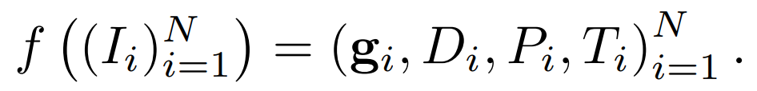
Method 2: Visual Geometry Grounded Transformer
VGGT:
a feed-forward neural network that performs 3D reconstruction from one to hundreds of input views of a scene.
predicts a full set of 3D attributes: camera intrinsics and extrinsics, point maps, depth maps, and 3D point tracks
f: function
N: size of image sequence
I_{i}: RGB image
g_{i}: camera parameters g = [q, t, f]
([rotation (4), translation (3), field of view (2)])
D_{i}: depth map
P_{i}: point map
T_{i}: Tracking
Notes:
接下來我們介紹 VGGT。不同於傳統逐步驟計算的方法，這是一個前饋神經網路 (Feed-forward neural network)，可以對單張到數百張的影像，進行 3D 重建。
這個模型會直接預測出一整套完整的 3D 屬性，也就是說，它能一次把相機的內參、外參，以及場景的點雲 (Point Maps)、深度圖 (Depth Maps) 和特徵軌跡 (Point Tracks) 全部算出來。
我們來看一下它的數學定義與符號：
這裡的 f 代表就是這個 network 本身。
N 代表輸入影像序列的長度。
I _i 是第 i 張輸入的 RGB 影像。
而輸出的變數主要有四個：
首先是 g_i，代表相機參數。它包含了 4 維的旋轉向量 q、3 維的位移向量 t，以及視野 f (Field of View)。
D_i 是深度圖
P_i 是點雲圖，跟深度圖一起用來描述幾何結構。
最後是 T_i，代表特徵點在不同視角間的軌跡。

Slide 17
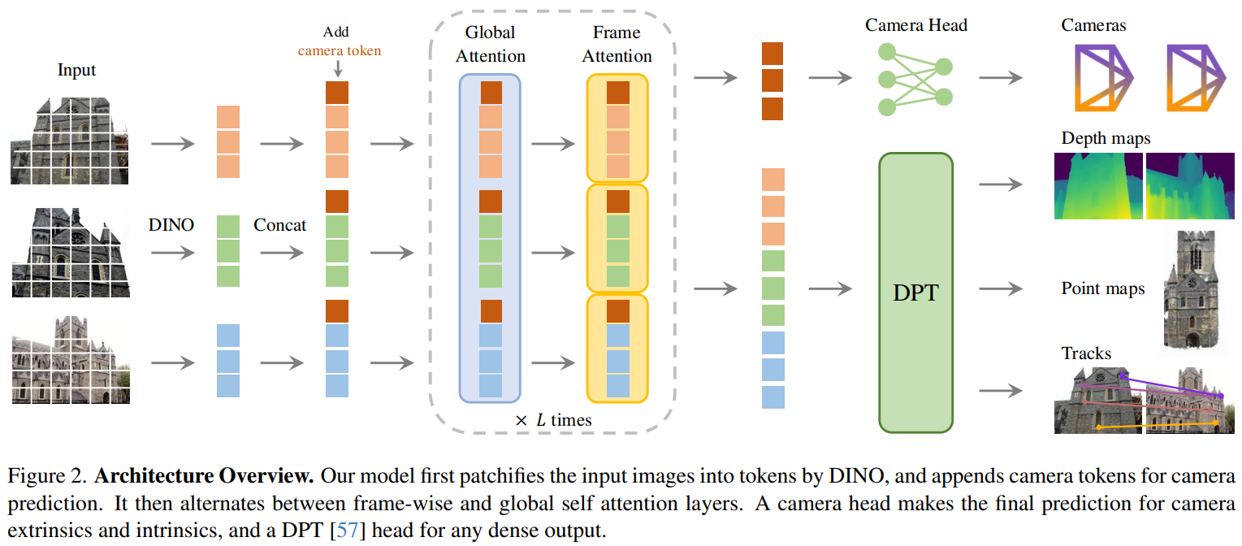
VGGT: Visual Geometry Grounded Transformer
DINO: DIstillation with NO labels
DPT: Depth, Point, Track
VGGT - Methods
Alternating-Attention (AA)
Prediction Heads

Slide 18
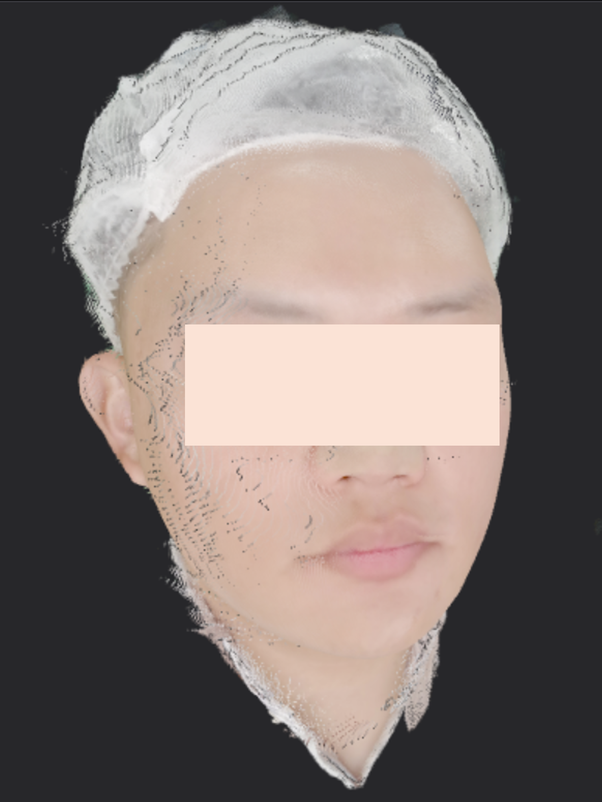
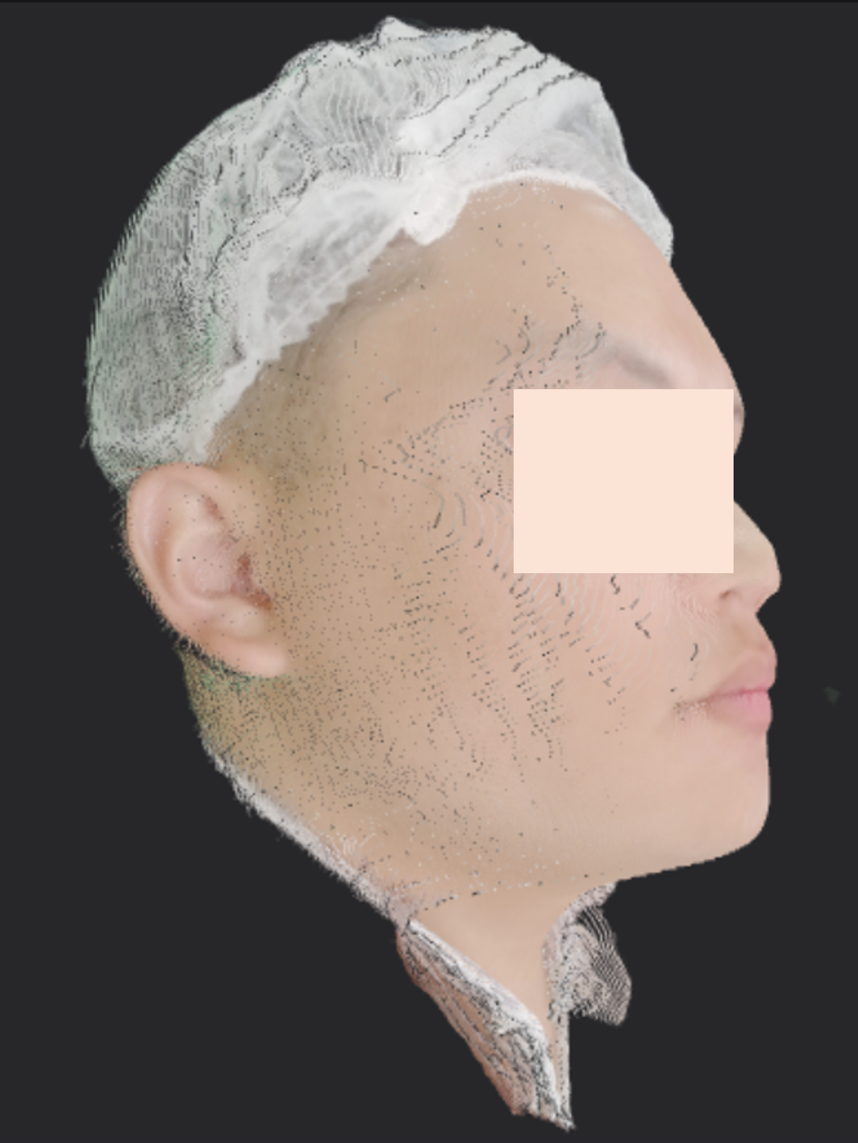
VGGT - Results
VGGT: Visual Geometry Grounded Transformer
Different Confidence Level: 5, 50 (1~100)

Slide 19
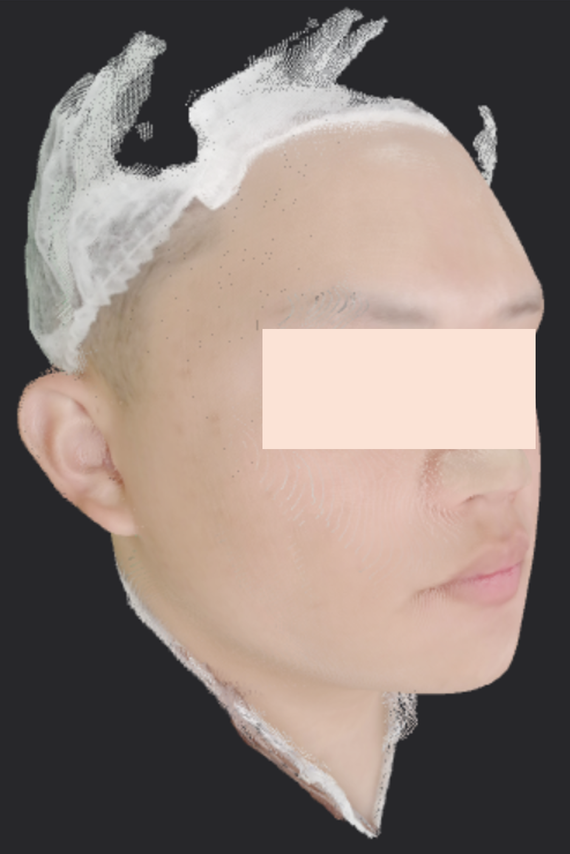
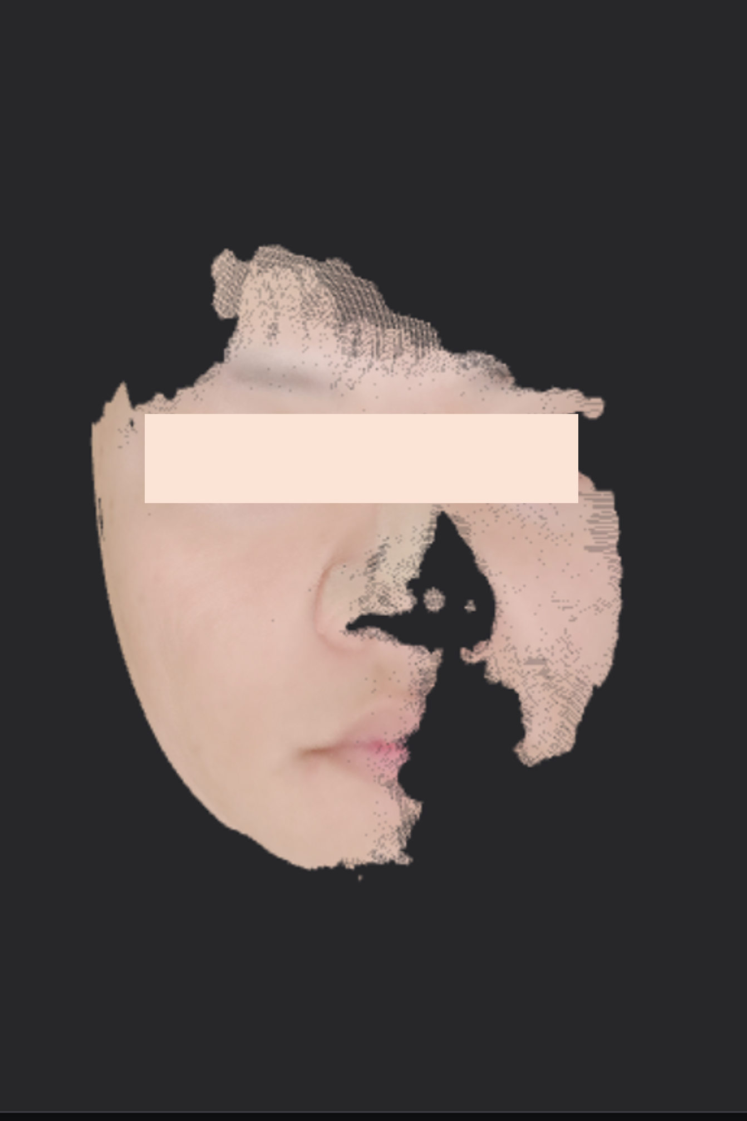
VGGT - Results
VGGT: Visual Geometry Grounded Transformer
Different Confidence Level: 70, 95 (1~100)

Slide 20
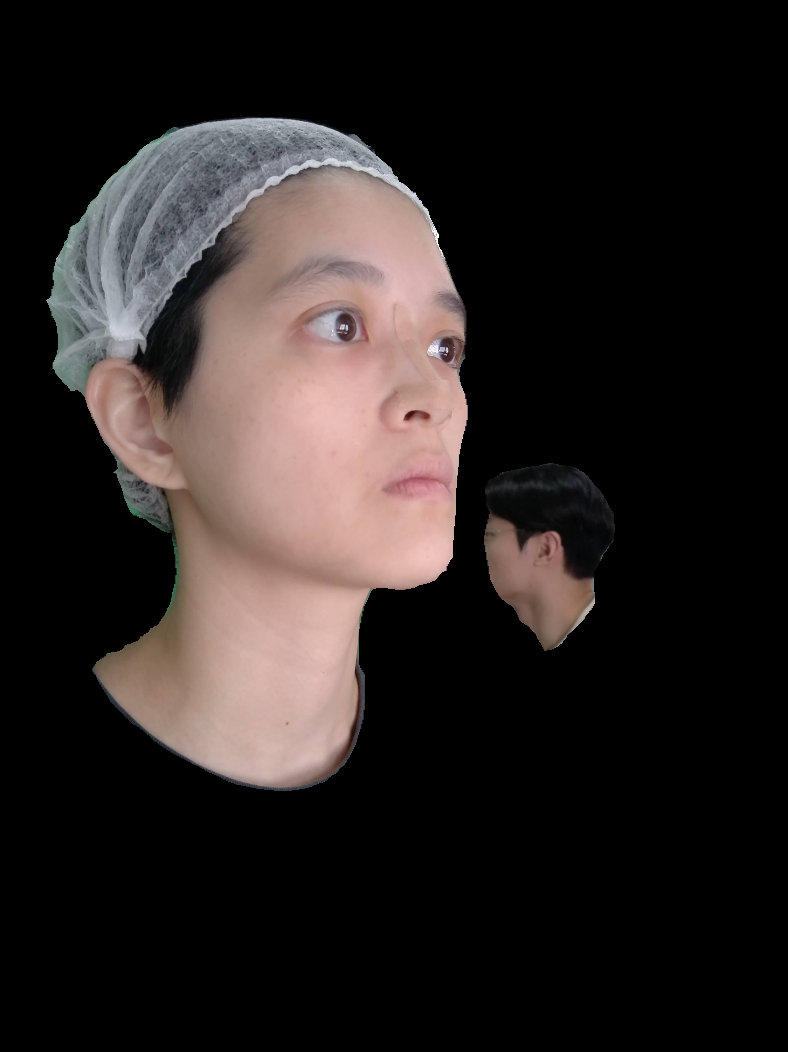
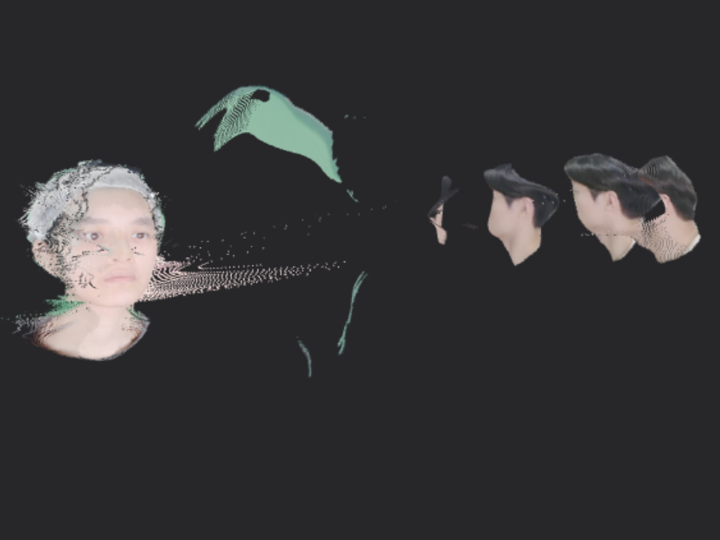
VGGT - Results
VGGT: Visual Geometry Grounded Transformer
Different Confidence Level: 50 (1~100)

Slide 21
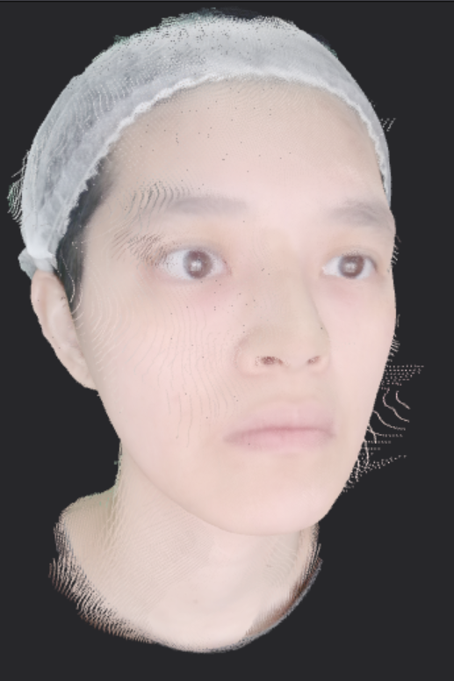
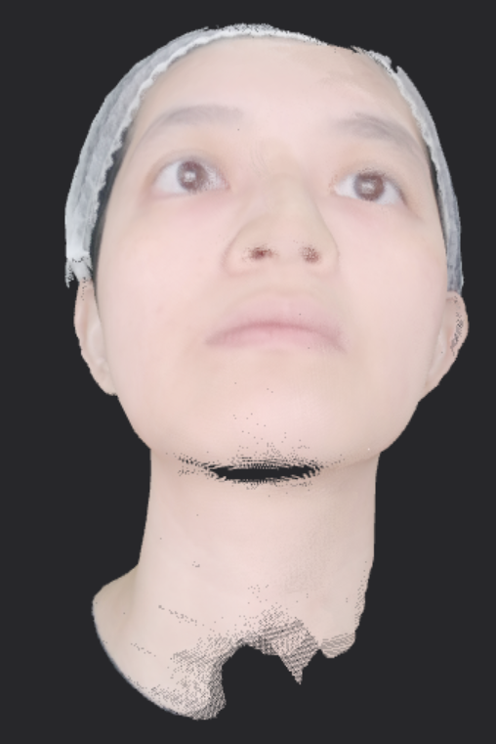
VGGT - Results
VGGT: Visual Geometry Grounded Transformer
Different Confidence Level: 70, 80 (1~100)

Slide 22
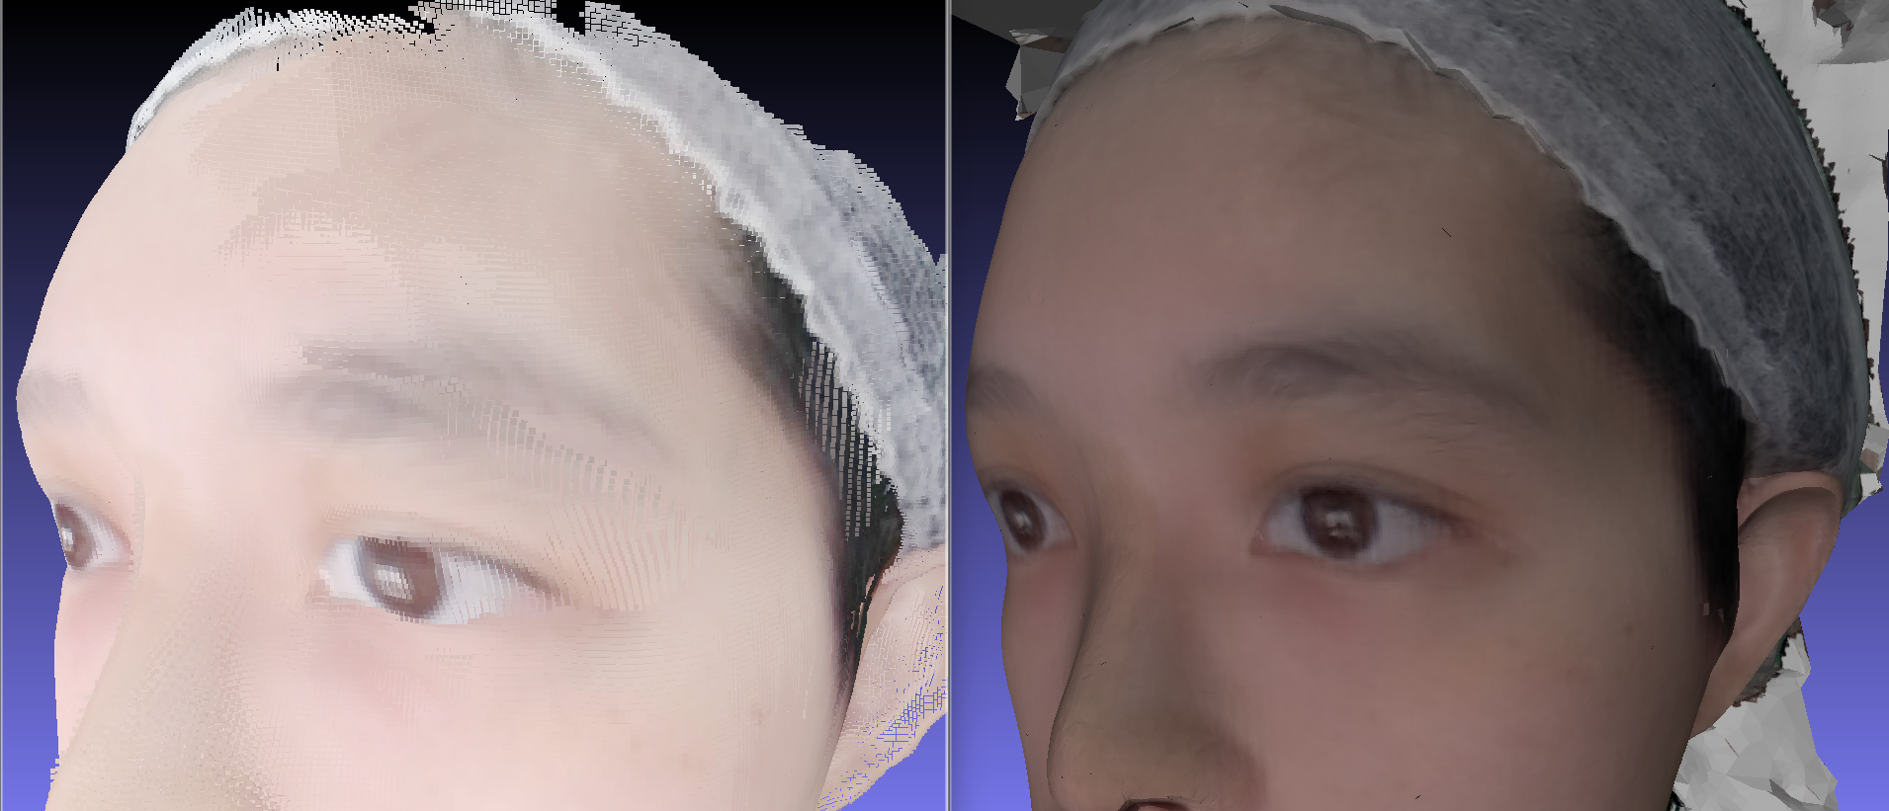
VGGT - Results
VGGT: Visual Geometry Grounded Transformer
VGGT confidence 80 vs. Meshroom results

Slide 23
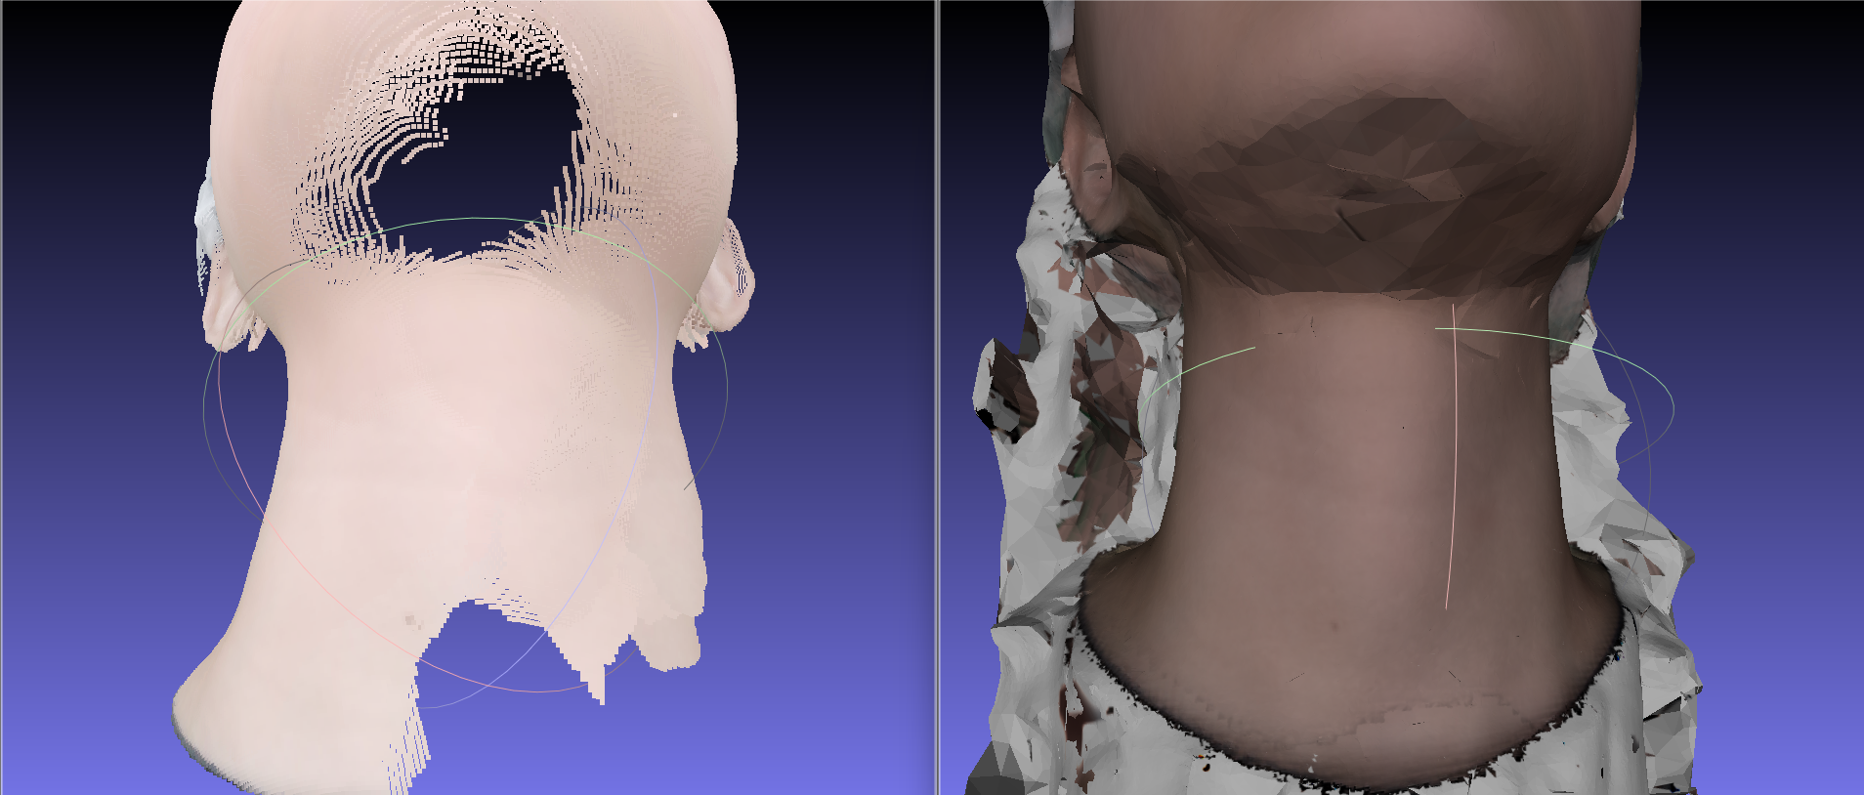
VGGT - Results
VGGT: Visual Geometry Grounded Transformer
VGGT confidence 80 vs. Meshroom results

Slide 24
Summary
SfM: Structure from Motion
MVS: Multi-View Stereo
3D FR: 3D Face Reconstruction
VGGT: Visual Geometry Grounded Transformer
Method: VGGT or Meshroom pipeline using SfM + MVS
Steps:
Take photos.
Perform background removal on the photos.
Do 3D FR using VGGT or Meshroom pipeline.
Results: Get 3D face models with yield over 90%.

Slide 25
References
[1] Wang J., Chen M., Karaev N., Vedaldi A., Rupprecht C., & Novotny D. (2025) VGGT: Visual geometry grounded transformer. Proceedings of the IEEE/CVF Conference on Computer Vision and Pattern Recognition (CVPR), 2025, 5294-5306 https://openaccess.thecvf.com/content/CVPR2025/html/Wang_VGGT_Visual_Geometry_Grounded_Transformer_CVPR_2025_paper.html
[2] Vaswani, A., Shazeer, N., Parmar, N., Uszkoreit, J., Jones, L., Gomez, A. N., Kaiser, L., & Polosukhin, I. (2017). Attention is all you need. Advances in Neural Information Processing Systems (NeurIPS), 30, 6000–6010. https://proceedings.neurips.cc/paper/7181-attention-is-all-you-need

Slide 26
Digital Camera and Computer Vision Laboratory
Department of Computer Science and Information Engineering
National Taiwan University, Taipei, Taiwan, R.O.C.
Thank You for Attention
Presented by: Li-Jung Chen (陳莉蓉)
Phone Number: 0988670963
E-mail: eva111708@gmail.com
Advisor: Chiou-Shann Fuh (傅楸善)

